Slide 1

GROUP MEMBERS
N* | NAMES | MATRICULES
1 | ETOH KIERA EKUTY | FE20A035
2 | GWANA JUSLINE AKAH | FE20A047
3 | YUVEN BRIAN | FE20A125
4 | LASSI FOKOU BERICE JILDO | FE20A054
5 | AJONG NTI MAGCELOUS | FE20A006
First Skill
Second Skill
Third Skill
Conclusion
PAGE 1

Slide 2


Slide 3

INTERNET
PROGRAMMING
AND
MOBILE
PROGRAMMING
ASSIGNMENT

Slide 4










DIFFERENTS TYPES OF MOBILE APPLICATION
/ THEIR DIFFERENCES /THEIR CRITERIA
REVIEW OF MOBILE APPLICATION PROGRAMMING LANGUAGE (CRITERIA).
OUTLINE
NUMBER OF MOBILE APPLICATION DEVELOPPMENT FRAMEWORK AND THEIR COMPARAISON USING KEYS FEATURES .
HOW TO COLLECT AND ANALYSE THE REQUIREMENTS FOR A MOBILE APP TO BE DEVELOPPED.
HOW TO ESTIMATE THE MOBILE DEVELOPMENT APPLICATION COST.
PAGE 4

Slide 5

DEFINITION
What is a mobile application? It is a type of application software designed to run on a mobile device. Anyone planning to build an app for their business will have to answer the question: which type of mobile app do I want?.

Slide 6

There are 03 differents types of mobile application namely : a) Native mobile application
b) Web mobile application c) Hybrid mobile application
1) DIFFERENTS TYPES OF MOBILE APPLICATION
PAGE 6

Slide 7
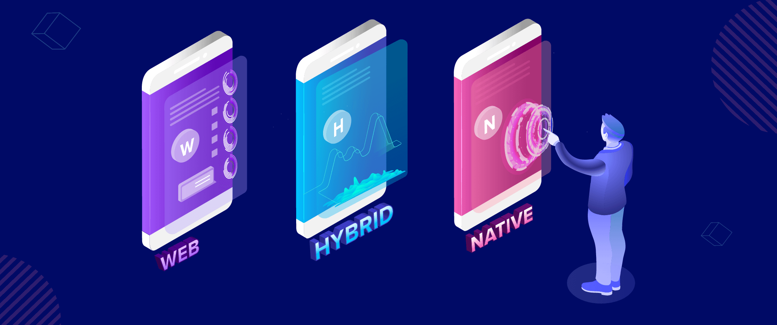

Slide 8
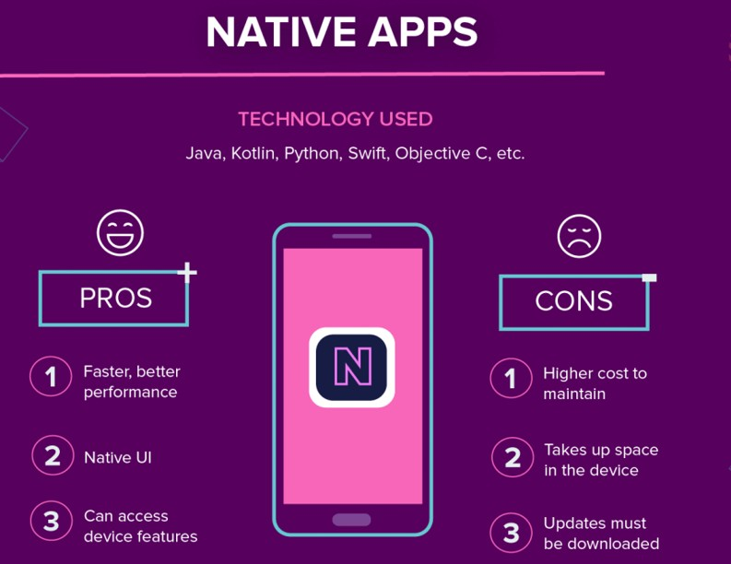

1-2) DIFFERENCES
First Skill
Second Skill
Third Skill
Conclusion
PAGE 8

Slide 9
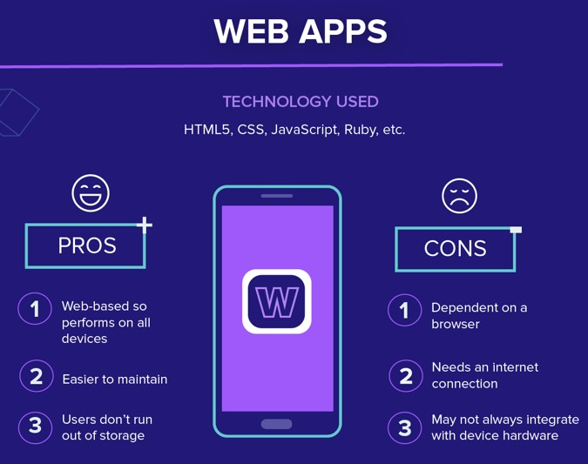

Slide 10
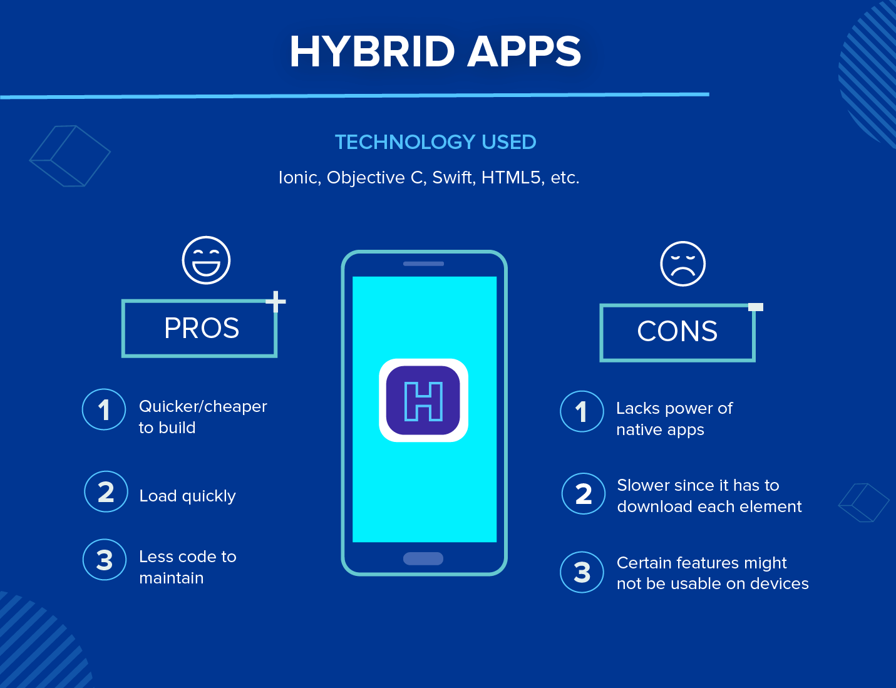

Slide 11
2) REVIEW OF MOBILE APPLICATION PROGRAMMING LANGUAGE
There are several mobile application programming languages such as :
For Native mobile app: Java, Kotlin, Python, Swift, Objective-C, C++, and React.
For Web mobile app : HTML5, CSS, JavaScript, Ruby .
For Hybrid mobile app : Hybrid apps use a mixture of web technologies and native APIs. They’re developed using: Ionic, Objective C, Swift, HTML5, and others.

Slide 12
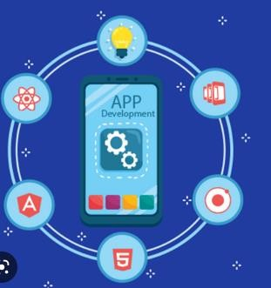
MOBILE APPLICATION DEVELOPMENT FRAMEWORK
First Skill
Second Skill
Third Skill
Conclusion
PAGE 12

Slide 13
2) DEFINITION
A MOBILE APPLICATION DEVELOPMENT FRAMEWORK :
It is a convenient software creation toolset used to simplified the process of developing a feature- rich and compatible mobile application.
There are many of them such as :

Slide 14

EXAMPLE OF MOBILE APPLICATION DEVELOPMENT FRAMEWORK

Slide 15
KEY FEATURES
Available open-source for free;
Compiles to JavaScript, Intel, and ARM;
Uses layered architecture;
Offers widgets that can be customized (icons, navigation, scrolling, among others);
Has rich motion APIs;
Provides an intuitive UI kit;
Automated QA testing and simple debugging;
Has a hot reload feature, allowing to see changes immediately without app reload.

Slide 16

2) REACT NATIVE

Slide 17
KEY FEATURES
REACT NATIVE is an open-source mobile app development framework that is based on JavaScript. It is noted for its ease of creating both iOS and Android applications, therefore React Native mobile app development is very popular among developers.

Slide 18
Is low-code (provides components and code that can be reused);
Available open-source for free;
Allows for achieving enhanced UI and impressive app performance;
Extensive React Native libraries;
Boasts top-notch APIs;
Has numerous platform-agnostic components (these include Text, View, and Image);
Simple migration due to third-party libraries support;
Well-adapted to various screen sizes;
Great compatibility with various extensions;
Easy maintenance;
Has an extensive community;
Low learning curve.

Slide 19

3) IONIC

Slide 20
KEY FEATURES
Available open-source for free;
Uses numerous JavaScript components (over 100 for Angular);
Has many themes and features like lazy loading;
Device plugins (eg., for accessing the camera or Bluetooth);
Uses Webviews and intuitive mobile-optimized components for UI;
Adaptive styling;
AOT compiling, touch-optimized gestures, and pre-rendering;

Slide 21

4) Apache Cordova

Slide 22
KEY FEATURES
Based on: HTML5, CSS3, and JavaScript.
Available open-source for free;
Plugins for accessing hardware like the camera, GPS, etc.;
CLI (command-line interface);
Native device API access;
Scenarios for offline usage;
Large community.

Slide 23
QUESTION 4 : HOW DO WE COLLECT AND ANALYSE THE REQUIREMENTS FOR A MOBILE APP TO BE DEVELOPPED ?.

Slide 24
In order to collect and analyze the requirements for a mobile app we must follow the steps bellow :
1 ) Strategy Development
2 ) Analysis and Planning
3) UI/UX Design
4) App Development
5) Application Testing
6) Deployment

Slide 25
QUESTION 5 : HOW TO ESTIMATE THE COST OF A MOBILE DEVELOPMENT APP ?
The estimation of a mobile development app is determined by :
Supported platform
Maintenance
Development Team Size
Team’s Location

Slide 26




